Slide 1

A Holistic View of LLVM’s Code Layout Passes
By Madison Bradley and Sarah Thomson

Slide 2

Our Project
[1]
Nelson’s words: “Gain a holistic understanding of all of the passes in LLVM that change code layout. Is there a better solution?”
[1] https://www.ualberta.ca/en/computing-science/news-and-events/news/2021/march/nelson-amaral-awarded-with-2020-remote-teaching-award.html

Slide 3

So, what does that mean?
“Holistic understanding” = global understanding across the entire pipeline.
Across all IR units (module, function, block, etc.)
Bridge the gap between IR-level transformations and target-specific ones.
Code layout transformations = anything that changes the ordering of the units of code
Transformations changing function, basic block, and instruction ordering
So, we want to understand how, when, and where units of code move across the ENTIRE pipeline.

Slide 4
Why do we care?
Our goal: find a better solution for pass orderings!
What do we find if we consider all code layout transformations?
There may be redundancies
Canonicalization passes that are done repeatedly across the pipeline
Passes that are done and then reversed
Inlining -> outlining
Tail duplication -> tail merging
If they exist, can we reorder things to minimize these redundancies?
At the very least, even if we don’t find anything, we become experts on the LLVM pass pipeline

Slide 5
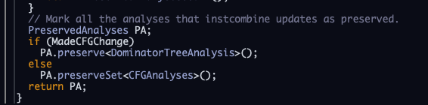
Isn’t that a lot to consider though?
That’s why we will not focus on passes that only modify instruction order, and only analyze passes that modify the CFG.
We can kindly get hints via PreservedAnalyses
The pass manager explicitly identifies what analyses are preserved after a specific transformation pass
Some passes state they preserve the CFG - we can ignore these passes entirely
But some are less specific (they say they preserve nothing), which is less helpful
[2]
[2] https://llvm.org/doxygen/AggressiveInstCombine_8cpp_source.html#l01008

Slide 6
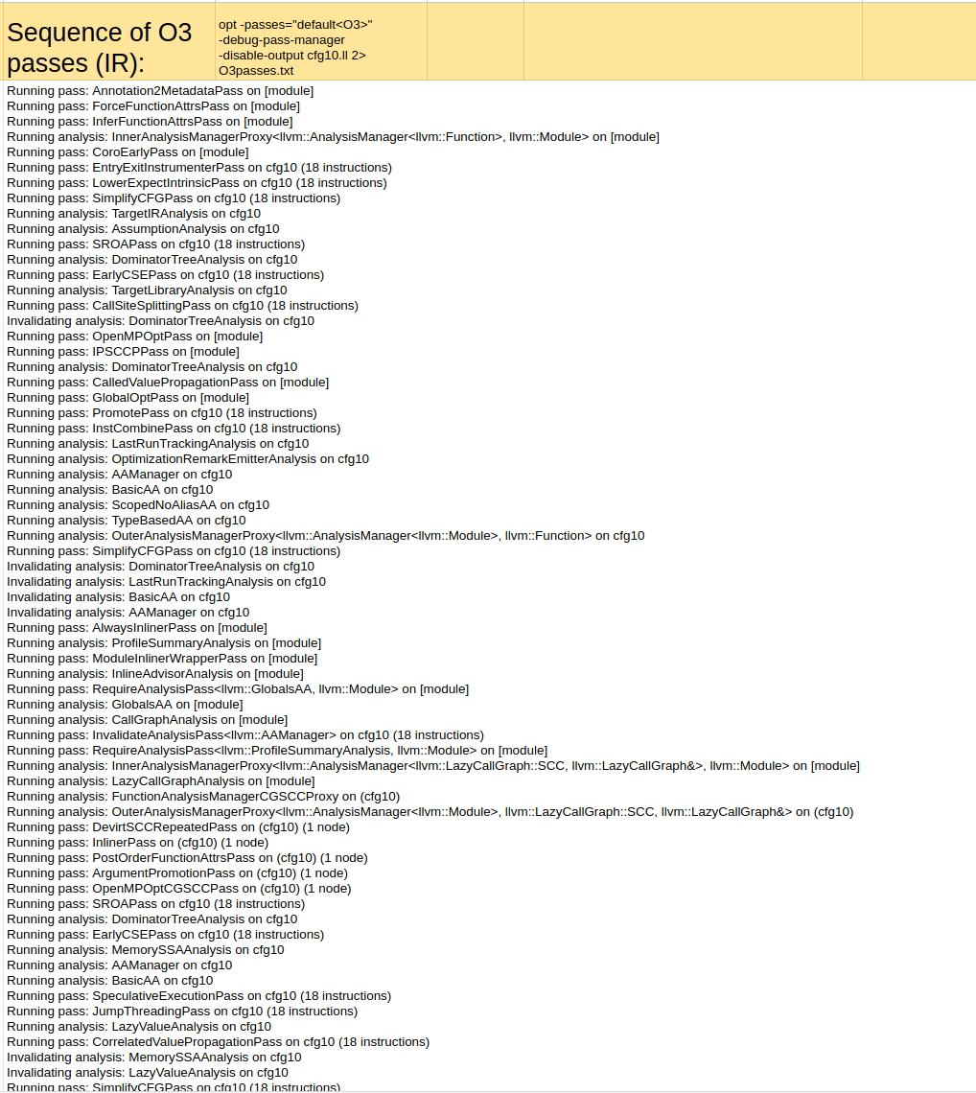
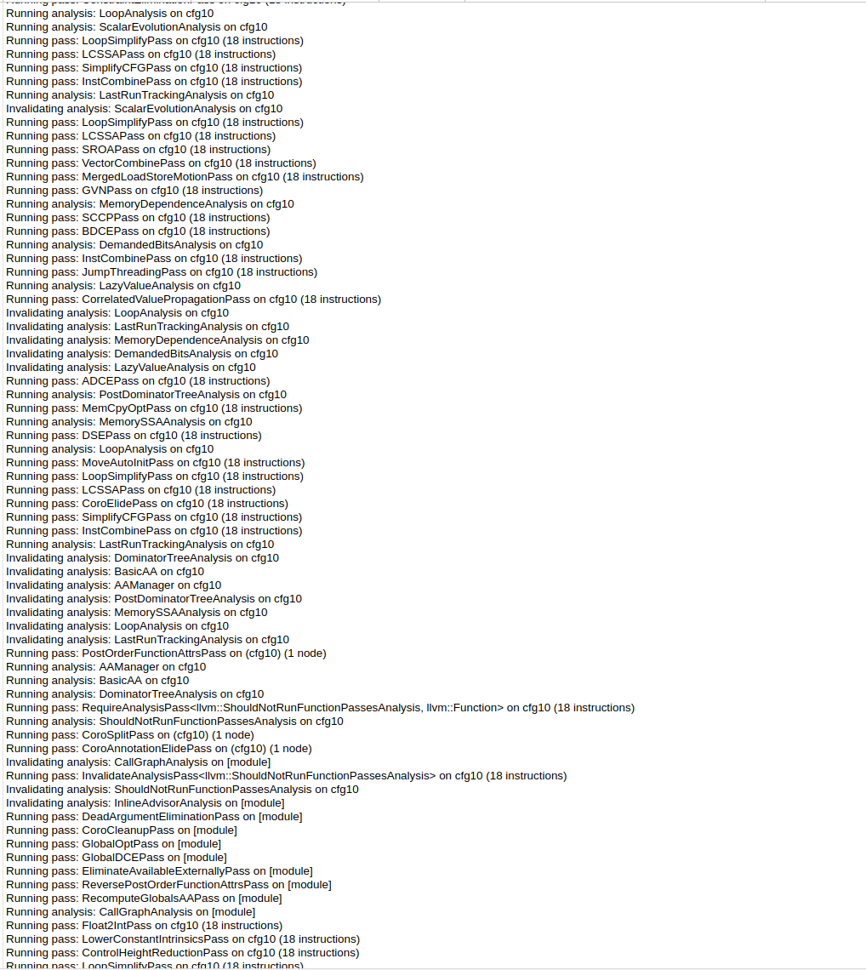
AND MORE!

Slide 7
Our Current Plan

Slide 8
Our Current Direction
Information gathering/filtering
Information representation
Represent pass actions
Compare pass results
Evaluation

Slide 9
Step 1: Information Gathering
Information gathering/filtering
Information representation
Pass actions
Pass results
Characterize optimization pipelines (O0/O1/O2/O3)
What passes do we care about?
Are all passes in a pipeline relevant?
Many PGO passes - do we care?
What requirements are needed for each pass?
Passes depend on analyses and other transformations
What is the ordering of the passes in the pipeline?
Build an in-depth reference guide for each pass, and where the source code is located
Evaluation

Slide 10
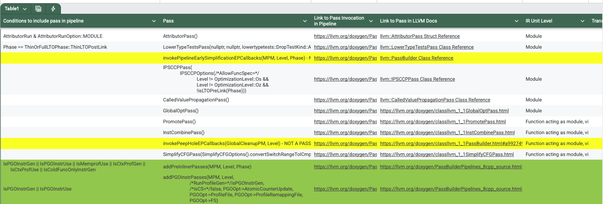
Step 1: Information Gathering - Oct 10th
Information gathering/filtering
Information representation
Pass actions
Pass results
We’re already there!
Creating a Google Spreadsheet with this information
Each sub-pipeline has its own tab
We will share this once we’re done
Evaluation

Slide 11
Step 2: Information representation - Oct 31st
Information gathering/filtering
Information representation
Pass actions
Pass results
Once we have the data, how do we represent it?
Build up a graph representation
Include each pass as a node
Edges show the ordering of passes and pass dependencies
Edges also show analysis invalidations
For visualization purposes, and so we can better reason about the pipeline
PS: Would be really cool to build an interactive visualization tool
Enable/disable certain conditions (eg. optimization level, PGO passes)
Zoom in on subsections of the pipeline (eg. module simplification)
Checkboxes to enable visualization of certain components
Enter code to see how it flows through the pipeline à la Godbolt
Evaluation

Slide 12
Step 3-1: Pass Actions - Nov 19th
Information gathering/filtering
Information representation
Pass actions
Pass results
Can we search for redundancies/improvements by collecting and exploring the actions that are done between passes?
REDUNDANT
Evaluation
BB0
BB1
BB1
BB0
BB1
BB0
BB0
BB1
Pipeline

Slide 13
Can we find or learn representations of pass actions and their inverses?

Slide 14
Step 3-2: Pass results - Nov 19th
Information gathering/filtering
Information representation
Pass actions
Pass results
What can we learn from the outputs of each pass or different pass orderings?
Evaluation
Layout pass 1
Layout pass 2
Layout pass 3
input.cpp
input.cpp
input.cpp
riscv.asm
riscv.asm
riscv.asm
Analyze

Slide 15
Can we Automate?
Information gathering/filtering
Information representation
Pass actions
Pass results
There is a TON of data to look at.
Not a lot of it is easy to read.
Likely will not be able to manually look into ALL of the results
Permuting passes and pass orderings
Different input files
Source code specifics
IR/MIR at multiple stages in the pipeline
etc…
Evaluation

Slide 16

ML
Could use ML models such as CodeT5+
Transformer model
Creates vector embeddings for code
Good at clone detection
[4] https://www.alexander-patzer.de/codet5/

Slide 17
Step 4: Evaluation & Report Writing - Dec 10
Information gathering/filtering
Information representation
Pass actions
Pass results
If we find redundancies, we need to brainstorm ways to work around them.
We also need to evaluate whether sidestepping these redundancies is actually worth it.
Maybe every redundancy is definitively needed in the pipeline.
We’ll compare the performance of reorderings with the original code using standard metrics
Performance/speedup, compilation time, code size
Use SPEC CPU 2017 benchmark suite
Evaluation

Slide 18
Risks/Benefits of our Plan

Slide 19

Will we find a solution?
Maybe.
We do not fully know what a solution would look like, because we do not know if/what redundancies exist (yet).
The major risk is that there are no redundancies, and we spent all this time looking for something that doesn’t exist.

Slide 20

Will we find a solution?
The pipeline may be perfect just as it is.
At the very least, we will learn a lot and create documentation and tools that are helpful to others.
Spreadsheet detailing the entire pass pipeline
Visual representation of the pipeline
Some CDOL members have already expressed interest in using these tools in the future

Slide 21
Target Architecture?

Slide 22

We are familiar with the ISA.
ISA is simpler.
Newer, more spots for improvement?
We have no physical hardware
[5] https://www.dfrobot.com/blog-13481.html

Slide 23

We have a lot of available hardware
More complex
[6] https://www.youtube.com/watch?v=MgYOa-EkVrg

Slide 24

[7] https://milkv.io/jupiter

Slide 25
Bibliography
[1] https://www.ualberta.ca/en/computing-science/news-and-events/news/2021/march/nelson-amaral-awarded-with-2020-remote-teaching-award.html
[2] https://llvm.org/doxygen/AggressiveInstCombine_8cpp_source.html#l01008
[4] https://www.alexander-patzer.de/codet5/
[5] https://www.dfrobot.com/blog-13481.html
[6] https://www.youtube.com/watch?v=MgYOa-EkVrg
[7] https://milkv.io/jupiter

